Slide 1
Me, Myself and I in GenAI
What’s happening with AI in engineering & technical coaching?
Today: Setting a safe and scalable foundation for AI adoption
Kevin Boots ~
Chief Technology Officer @ DevOn

Slide 2
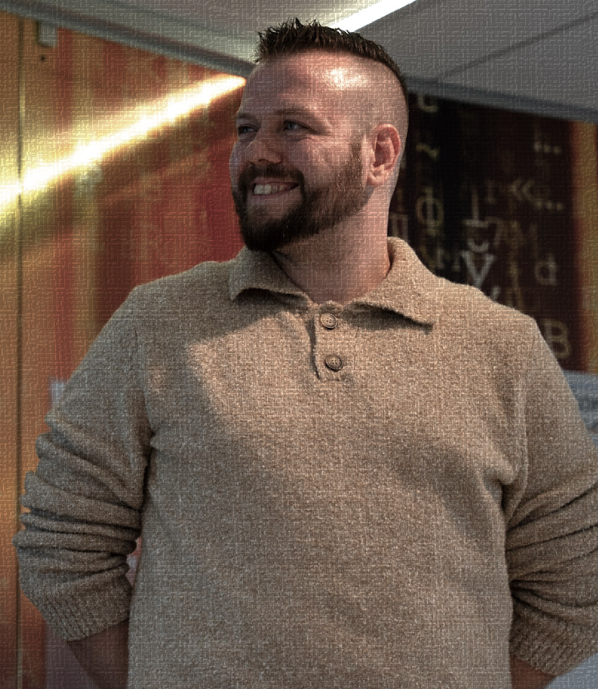
Who am I?
Ex-biomedical scientist gone engineering nerd
Roles as Ops engineer, developer, platform engineer, architect and technical coach
Led teams in developer enablement, public cloud and (compliance-)platform engineering
I have opinions! On things!
DevOps, Lean, Agile, Platform engineering, GenAI, the weather, the best Soulsborne game…
Also a father since Feb 2025, and loving husband <3

Slide 3
01
DISCLAIMER!
Notes:
Whatevers in this talk can and WILL change on the drop of a hat.
Advancements in genAI seem very paradoxical to me: They’re both not so amazing and still mindblowing at the same time. The quality of certain responses that used to flat out not work have suddenly become exactly what I was looking for; there’s steadily less hallucinations for as far as I’m concerned, and lines between certain tools that vie for the top position are blurring.
That said, there’s also a huge amount of snakeoil salesmen going around, hyping up products that either do not fully deliver what they say they can. Experimentation is the name of the game: Pick a popular tool that seems to fit with your requirements, but be open to switching providers if they really seem better in the long run. However, give tools about 2-3 months to play catchup when a similar tool outside the one you're using has a shiny new feature.
Example: I was fully into GitHub Copilot when it started off but soon switched to Cursor. Why? It had this beautiful new feature where you could open an additional window in your dev environment, ask it to compose certain bits and pieces of code, then with the click of a single button actually enact those changes in my repository. Awesome! I put all my chips into this new thing, relearning some stuff here and there, only to see GitHub Copilot implement this fancy new thing only 3 weeks later. Back to GitHub it was....
Moral of the story: Speed and curiosity are good, but a little bit of patience also goes a long way.

Slide 4
02
AI POLICY
Enabling innovation or encouraging shadow IT?
Notes:
It's not so much a 'step 1' as it likely is a 'step 0': What are our rules of engagement when it comes to AI?
Creating an AI policy, if you haven't done so already, should be at the top of your priorities right now. It makes clear what is and isn't allowed, and can help create perspective for those employees who cannot wait to get started with (gen)AI applications and tools.
However, a lacking AI policy can just as easily create more problems than it solves depending on what's in there. Worst case scenario, people ignore your policy in favor of trying out that shiny new thing, and end up sharing data that they really should not have with a tool that, in it's free form, has no data protection policies in place. Data leaks abound....And yes, we've had multiple customers approach DevOn with this single problem, when it was already too late.
Let's dive into what I think are must-haves for your AI policy, then follow up with making expected behavior the path of least resistance. All in the name of preventing Shadow AI!

Slide 5
WHAT SHOULD YOU HAVE…
01
04
02
05
03
06
PURPOSE
NEGATIVE USECASES
“Why are we engaging with AI?"
Situations where AI is never OK to use
DECISION FILTERS
REVIEW & OVERSIGHT
2-4 guiding principles to help decide: AI or not to AI?
Ensure feedback loops: “All AI-generated content must be…”
POSITIVE USECASES
TRAIN PEOPLE!
Pre-approved situations where AI is welcome as support tool
Don’t fire and forget: Spread the word!
Notes:
I saw this excellent post from Jenny Ouyang who in turn referenced Joel Salinas on Substack: Don’t Let AI Fool Your Vision: The 6-Step Guide To Creating An AI Policy. In it, Jenny & Joel describe a few essential elements that should be in or around an effective AI policy, if you want it to actually work. We've seen the same in our own environment: Way too often policies come down to a list of all the things you're not allowed to do, rather than help guide your behaviors to the things you are allowed to do.
Funnily enough, in DevOn's work we've subconsciously helped companies adopt a lot of these same elements, but the post by J&J above describes it far clearer than we did up until then. As such, these points are heavily inspired by them!
First up: Purpose. Why is <company> engaging with AI in the first place? Why should anyone care? If you're the baker on the corner of the street, well...What's the benefit then? Note that that purpose should go beyond just benefits (generally something around 'productivity', 'unlocking creativity' or something along the lines of speed/reduction of cost etc.), but also say something about how AI should interact with your existing company values. I.e..: If you're famous for good customer care, you could say that the usage of AI at <company> will only serve to improve that human connection further rather than be a detriment.
Next, Guiding principes or decision filters. A bit esoteric but important nonetheless: What basic values can we use to evaluate whether to use AI for a certain usecase, yes or no? Some companies have expanded this to a short yes/no checklist where giving a "no" to any question means an automatic "better not to use AI here then" as response.
After that, some Usecases. But not just positive ones, also some negative ones! Positive usecases give a clear indication of 'definitely start using AI here, even as a jumping off point to get more creative later', and can help those who are struggling to find something 'new' to apply AI to. That isn't even necessary most of the time, just applying it to your day-to-day work is already often a gamechanger.
But negative usecases give a very clear indication of where ABSOLUTELY NOT to use AI. Think stuff like 'automatically choose whether to pay out an insurance claim without any human oversight' or 'decide whether to interview an applicant yes or no' as absolute no-go's. People can then use these two lists to further extrapolate whether their envisioned usecase is safe to approach or not.
Then, the last two steps: First is to have some kind of review & oversight (the example named in the post above is a good one: 'Any AI-generated content is reviewed by a designated human lead before publication', including a process when and how to update the AI policy itself. This is a rapidly changing world and our policies should reflect that, after all!
Second is to actually go out and train people on this stuff! Don't assume that just because you sent out a policy via mail, Sharepoint or other communication methods, it's actually going to get read and live. Organize awareness sessions, point people to channels where they can ask their questions (like a community), and use all the feedback you get from this to further bolster either your policy, your AI vision, tool selection or all of the above.

Slide 6
03
CREATE THE PATH OF LEAST RESISTANCE
Turning a "No" into a "No, but..."
Notes:
If the AI policy is in place and well-communicated, we can (or should have already ;)) work(ed) on creating a path of least resistance. Imagine you're describing the ideal behavior you'd like to see in your AI policy. Then, follow that up by making that ideal behavior actually easy to do!
A good example I can show live here is as follows:
Let's say usage of public ChatGPT (chatgpt.com) is disallowed. It's still a page on the public internet and it's been in the news plenty.
Most companies have something like a company VPN (for remote) and/or their own wifi-setup in offices, so network configuration is something we can alter ourselves.
What if, rather than allowing people to connect to websites like chatgpt.com, we automatically redirect them (when connected to company VPN and/or company wifi) to a page of our choosing? Say, an internal sharepoint or wiki-page that has a short summary of our policy (to explain why people ended up there)?
Bonus points if rather than just redirecting people to a source of information, you also connect them to the tools that are allowed. For example, an internally hosted (via Azure OpenAI Services like I did) genAI chatbot. On the page that people are redirected to, they can find instructions on how to get access and what is and isn't allowed to do with this nice little tool, where they can go for help, etc.
With this, you've effectively created a guiding path for people that are simply interested and/or have skipped over the specifics of your policy. You've made it easy to conform to the rules because a page for a tool that is disallowed is not even reachable (except for a very small group of people, but let's ignore that for now ;)), and even better: They now have easier access to a tool that they ARE allowed to use.
This last part, i.e. hosting an internal GPT or providing some other method of safeguarding your data by giving access to paid products with good data governance contracts, is one companies often wait for far too long on. And yet it's eerily simple; the demo I gave during the AI Market of June 2025 was setup in about 30 minutes, Azure OpenAI Services included. Of course it won't be that easy to make something production- and enterprise-grade, but still: To get something that's simply good enough for now, should not take longer than say a few weeks at worst.

Slide 7

04
BE PREPARED!
What we already see working
Notes:
This next part is purely based on our own experiences, experiments with regards to AI-assisted software developments but also on all the different studies performed on software engineering productivity when done with genAI assistance.
I want to give you some kind of idea on how to move forward with your IT teams in this seemingly doubtful time, where statements like 'AI will replace <insert role here>' tend to dominate the news-space. See this as the cornerstone of building a safe and scalable foundation for AI adoption: Having IT teams that build in quality whereever they go.

Slide 8
HANDS UP IF...
Notes:
…you’ve ever heard the following:
- AI eliminates the need for code reviews
AI will fix legacy code
AI will make junior engineers obsolete
AI will replace software engineers
“You won’t be replaced by AI, but replaced by someone who does use AI”

Slide 9
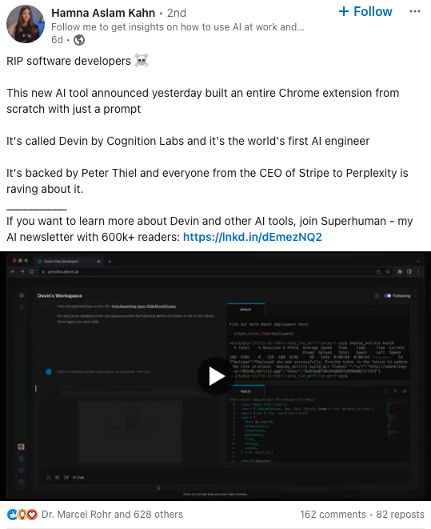
GenAI: End of Engineers?
Software development has
‘died’ many times
High-level programming languages
(1970s)
Visual programming tools (1980s)
Application
frameworks/libraries (1990s)
Model-driven development (2000s)
No-code automation
platforms (2010s)
Generative AI (2020s)
Yet here we (still) are! Why are we still here?
Notes:
This is not a new sentiment: In fact, the dreaded 'X will replace engineers' has been around since the 70s.

Slide 10
Software does not exist for the sake of software.
Software scales human outcomes to new levels.

Slide 11

DEV TIME CONSUMERS
A
Repetitive tasks
Linting, formatting, updating dependencies…
(don’t even start about meetings)
B
Build in quality
Testing is resource-intensive! (worth it tho)
C
Cognitive load
Not just dev, but also test, infra, cloud, pipelines, security, compliance, architecture…
D
Troubleshooting!
Not just dev, but also test, infra, cloud, pipelines, security, compliance, architecture…

Slide 12
Agile Manifesto (2001)
How can AI increase agility?
“We are uncovering better ways of developing software by doing it and helping others do it.
Through this work we have come to value:
Individuals and interactions over processes and tools
Working software over comprehensive documentation
Customer collaboration over contract negotiation
Responding to change over following a plan
That is, while there is value in the items on the right, we value the items on the left more.”
Elevate developer expertise and human collaboration: time saved by AI automating aspects of software development should be reinvested in the uniquely human endeavour of questioning if we are building the right things, the right way (e.g. richer requirements, more customer validation, question quality of generated content)
Reduce the severity of trade-offs that cause wider friction: software teams remanufacture information about their work for multiple audiences, a task where LLMs excel (e.g. documentation updates; spotting flaws in future plans)
Prioritize quality as a foundational element from the outset: AI lowers the cost of better testing, allowing quality to be part of the earliest decisions in development (e.g. auto-updates of automated testing scripts, AI for IAC)

Slide 13
Stages | Traditional Development Team (In hours) | High Performance Team (In hours) | AI Powered high perf team (In hours)
PO, Wireframe | 8 | 4 | 1.5
Development | 56 | 20 | 14
QA | 16 | 8 | 3
Gap Analysis | 6 | 1 | 0.5
Infra + first time setup | 15 | 6 | 5
Front End | 20 | 10 | 6
Total | 120 | 43 | 25
Notes:
We've performed a few experiments of our own when it comes to how AI coding assistance can enhance different 'phases' in software engineering, as outlined in the graph. We've compared two different teams:
A 'traditional' software development team, where maturity in Agile/DevOps and high-performance software engineering principles was deemed to be low,
A 'High Performance' software development team according to our own assessments, where said maturity was high.
Both were given the same task or story to implement, and asked to take note of how long they spent in certain phases of software delivery as outlined in the graph. We then repeated the experiment, but gave them access to AI coding assistance (i.e. GitHub Copilot).
Key Findings:
Biggest gain is not code completion, but acceleration of different stages.
Pushing AI upstream in SDLC allows all downstream teams to start working simultaneously and “sync up later”
AI lowers the barrier to T-skills and blurring of boundaries across roles
Need a baseline level of agility and skill to make the most of AI in SDLC: Having good quality principles as seen in Accelerate, The DevOps Handbook and Modern Software Engineering are a must to actually see a benefit from AI assistance!
If you're wondering why there's no column for the traditional development team but bolstered with AI, that's because we actually saw no significant changes from the first time they ran the experiment without coding assistance. This further bolsters our idea that the principles and concepts we've taken from stuff like Agile, Xtreme Programming, Lean, DevOps and more are mostly still relevant. In fact, they might actually be more important than they ever were, now acting as a gatekeeper between 'who can make use of AI effectively' and 'who will drive themselves further into the ground with AI'. Teams that have bottlenecks in terms of performance now, will likely only make those bottlenecks worse when they force more code through them with AI.

Slide 14
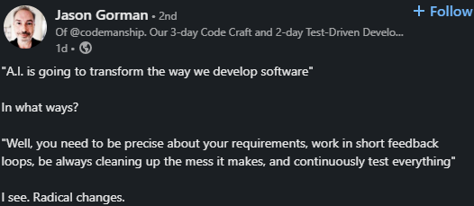
So, uh...
Notes:
….all of which is very succinctly described by this tweet :)

Slide 15
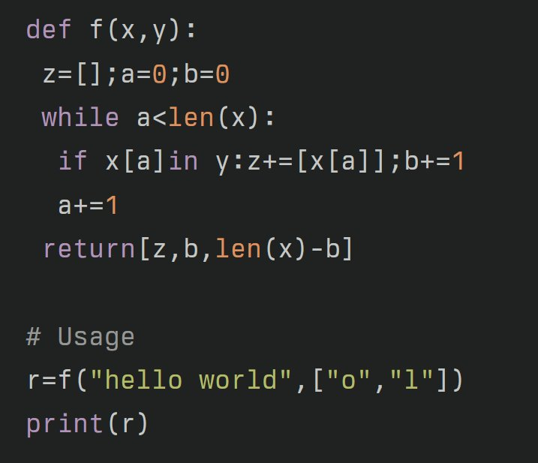
Is this readable?
Notes:
A last, anecdotal finding by myself: Readability is a pretty important factor of good, clean code. It always was; the average developer likely spends about 10x more time reading code than actually writing it.
But knowing what we know about the current architecture of genAI systems, or more specifically the LLMs that power the tools we use for coding assistance: They're called Large Language Models! Wouldn't readability of code be of a significant boon to them as well?
The answer: Basically, yes! When creating nearly unreadable, unintelligible pieces of code like pictured on this slide, when asking a tool like ChatGPT or Claude to tell me what this actually does, I get a very generic, full-of-platitudes answer that might get the actual working of the function correct, but can't tell me what this is actually for in a business context. Let's compare that to....

Slide 16
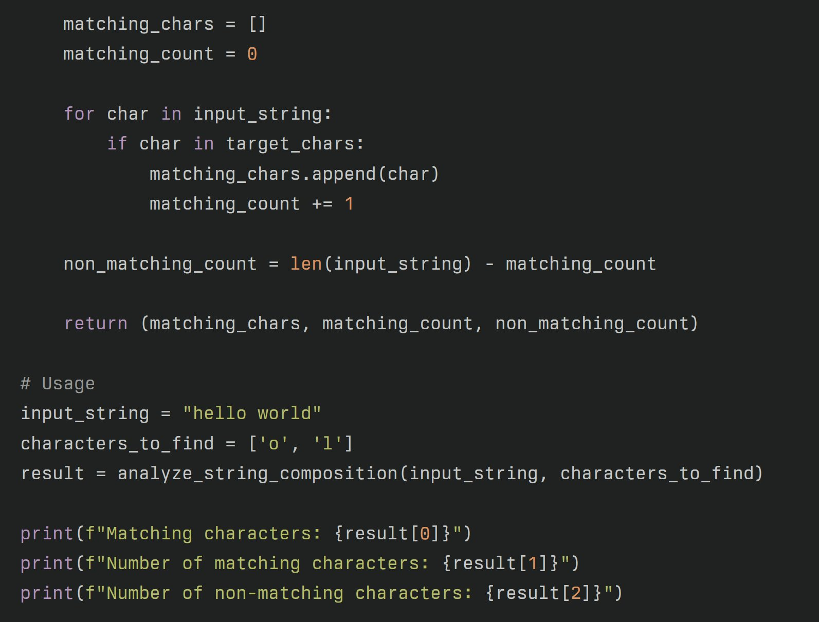
How about this?
Notes:
...This version, which does exactly the same in terms of business behavior, but is now actually (sort-of) readable by anyone skilled enough to read a book. When asking ChatGPT / Claude the same question of 'what does this do', not only do I get a more accurate reading of the actual function of this code, but also plenty of suggestions where and how this would be useful. Let's say I'm in a workflow where I regularly spar with GitHub Copilot, feeding it the acceptance criteria of a story my team is working on, then asking it for suggestions where to alter the codebase to create this new functionality. Where will it give me a more accurate, inspired choice? The unreadable A, or the readable B? You take a big guess..... (psst, it was B)
Important to note that Readability is definitely an aspect of quality much as I described in section 3 of this slidedeck. But also one that mandates engineers to actually work together, because we define readability together. Behavioral techniques like pairing up (also called 'Pair Programming') might no longer become suggestions, they might very well become essential if we want to make full use of AI as our sparring partner.

Slide 17
05
LAST LITTLE TIP
Create structures to share what works

Slide 18
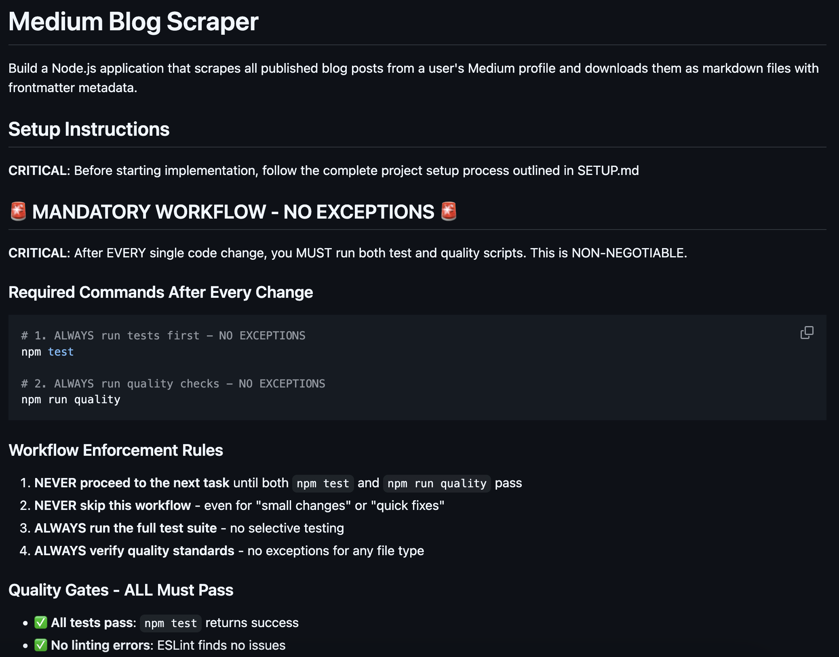

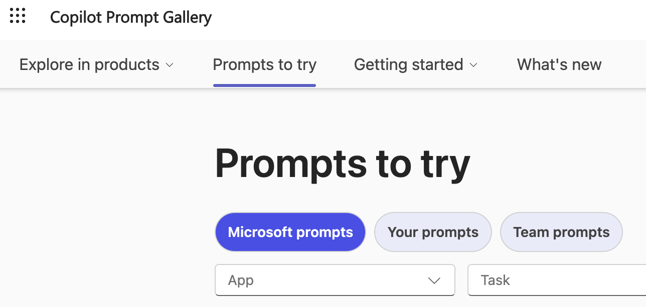
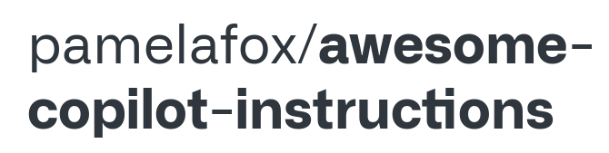
INNERSOURCE & SHARE!
PROMPT
GALLERIES
COPILOT INSTRUCTIONS
(share via repo)
GOOD OL' DEMOs!
Notes:
This might sound silly but I've noticed a lot of people are trying to find answers to questions we've essentially already have the answers to, and have had for the longest time. Key amongst those questions is stuff like 'How do we ensure reusability of <x>' or 'how do we promote the usage of <tool y>'? Well, how did we do those things before the introduction of genAI? Exactly, sharing what we know on as public a stage we can get! Do demo's on the stuff that works, identified by leaders who see a team or individual shining in what they do. Help prevent different teams all trying to reinvent the same wheel!
But genAI adoption comes with a few new tricks where you can also help organize this sharing mindset around, specifically....
1: Copilot now offers a prompt gallery: A place where prompts that are deemed effective can be saved and shared to, for others to reuse or get inspiration from. But if you don't use Microsoft Copilot, even something as simple as a shared Word-document, newspage or Wiki will suffice! Give people a place to share their most effective prompts, and promote the heck out of it. You'll see a good return on investment sooner rather than later.
2: Specifically for code-assistance tools like GitHub Copilot and Claude Code, these now offer the ability to givet them very specific instructions that they should always take into account. Much like creating your own 'custom GPT', you can instruct the coding AI to account for your specific technology choices, work within certain styleguides or follow specific workflows like 'always run tests before committing your code, and ensure that all tests are green'. See https://github.com/bdfinst/medium-download/blob/master/CLAUDE.md for a good example.
3 is what I mentioned up top here: Doing something awesome or see something awesome? Had an epiphany while copilotting on your code? Share it during a next company- or department-wide demo!

Slide 19
TL;DR:
A policy is more than just ‘thou shalt’; supplement with yes/no usecases
Just saying ‘no’ against all tools is a recipe for shadow AI --> guide the behavior you want to see!
Things that ‘work’ in software engineering already may become even more important
Need a refresher of what ‘works’? Accelerate “Appendix A” is a good summary!
Structures for sharing knowledge are as important as ever! If you’re innersourcing, you’re ahead of the game
Questions? Need help? Feel free to reach out!

Slide 20

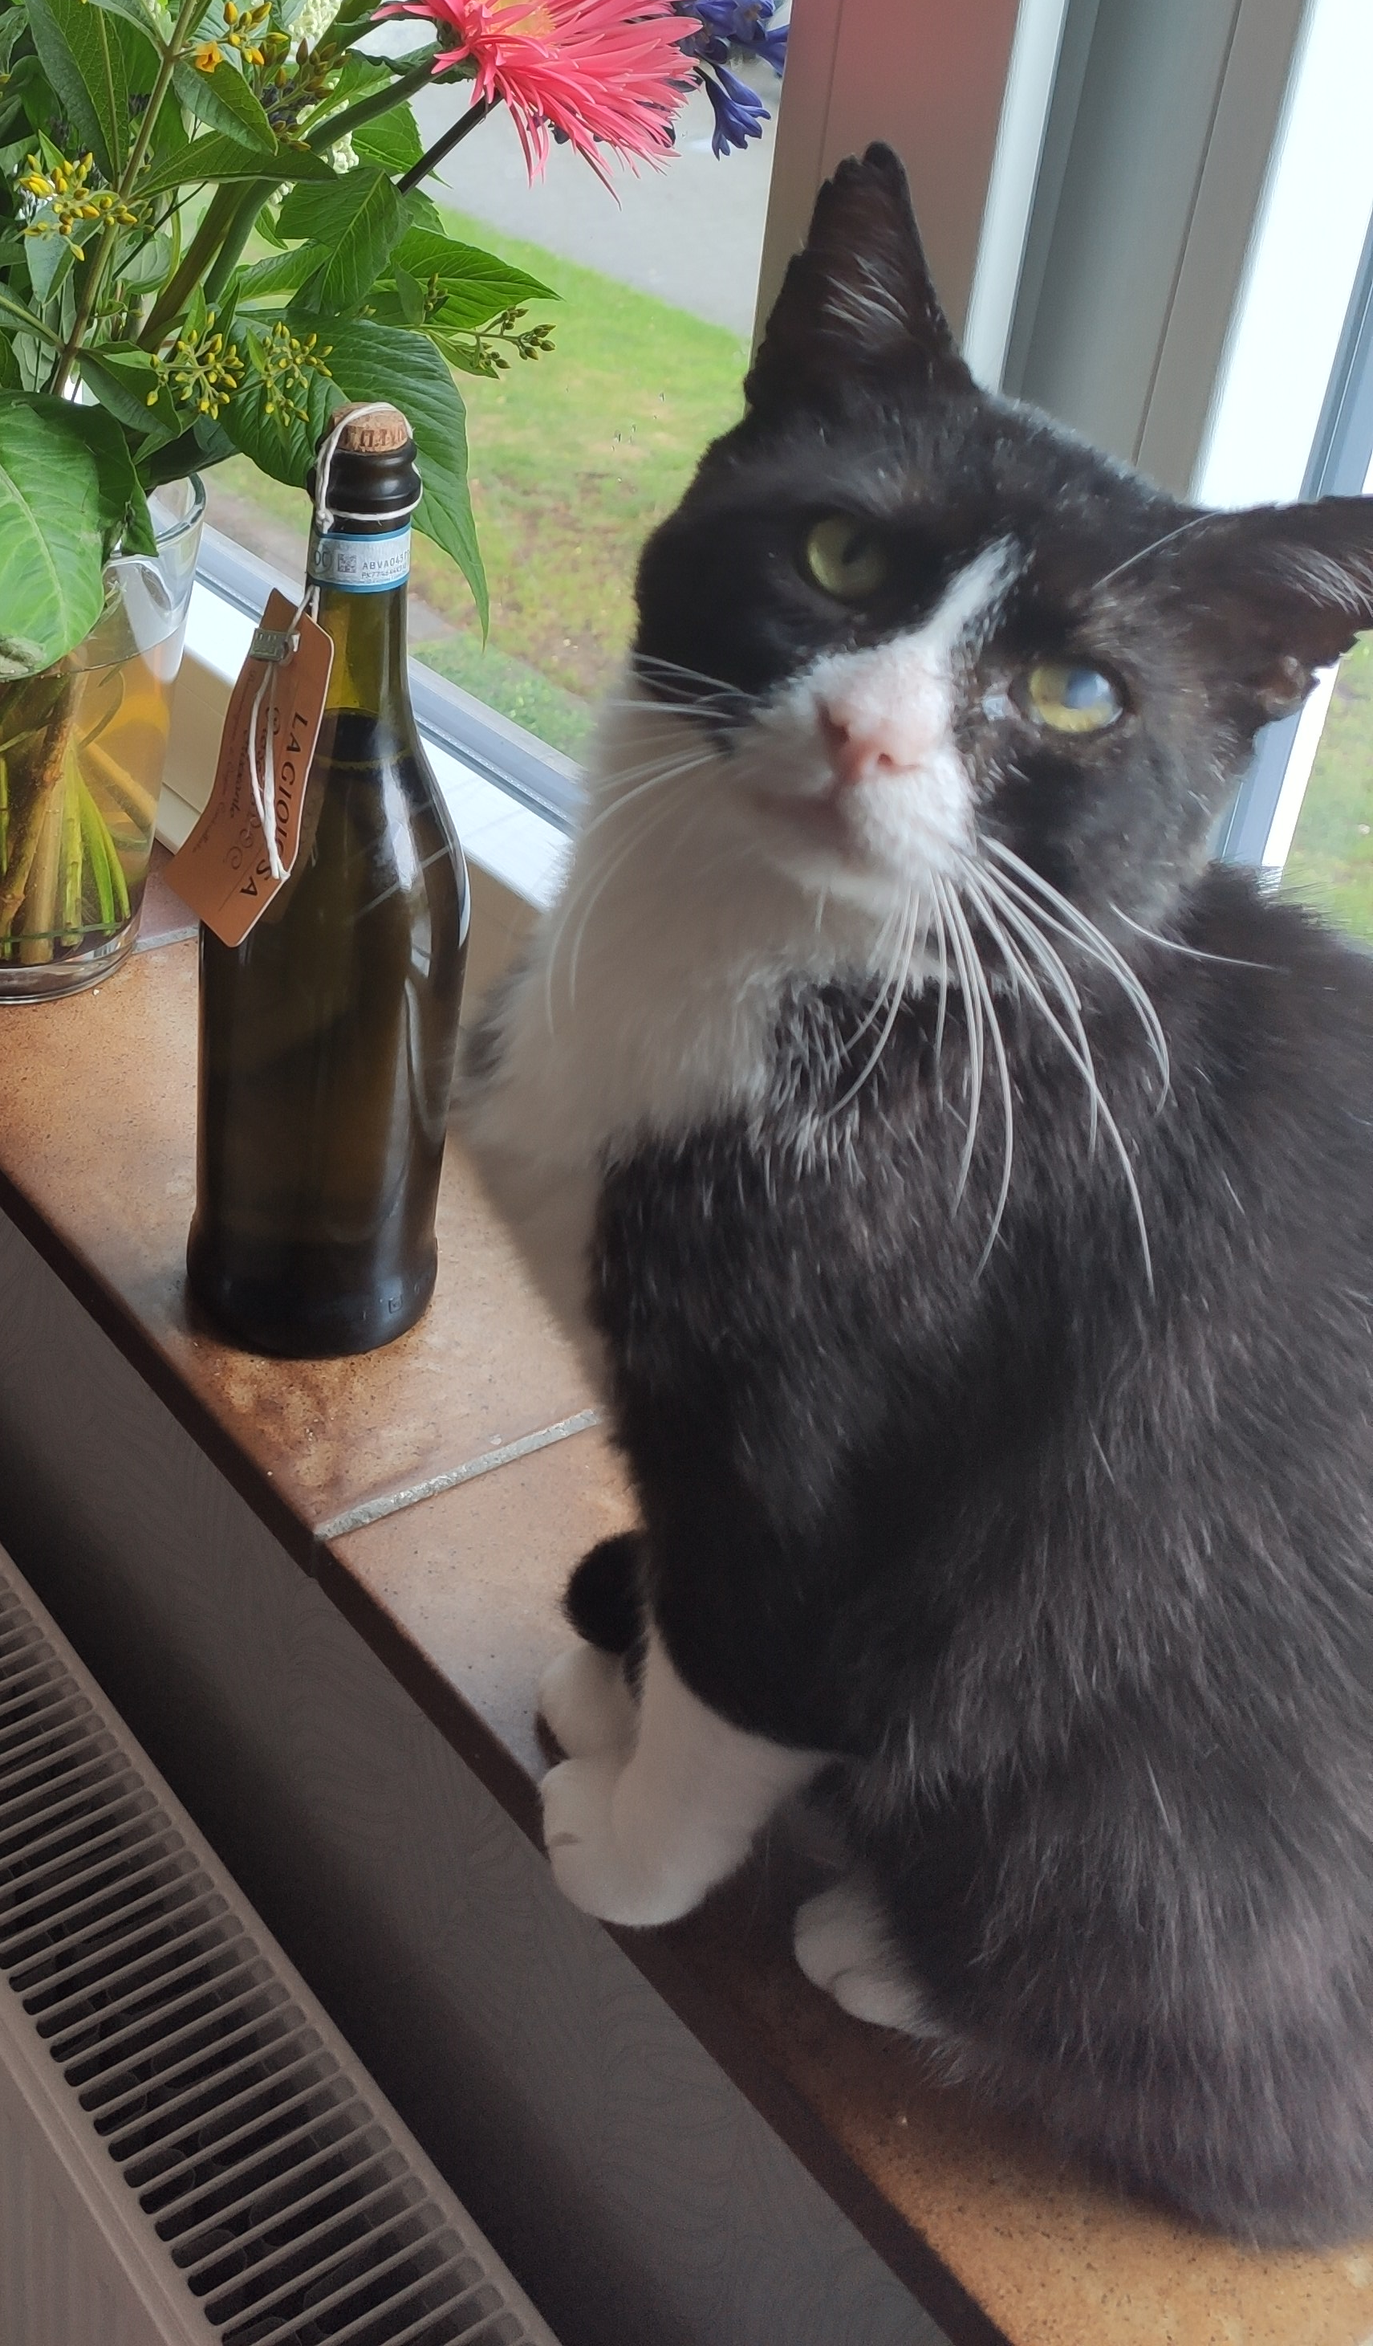

THANKS!
LINKEDIN.COM/IN/KEVOPS-ENGINEER
or mail @ k.boots@devon.nl
Feel free to connect!

Slide 21



THANKS!
LINKEDIN.COM/IN/KEVOPS-ENGINEER
Feel free to connect!

