Slide 1
AI voor Product Owners: Van Visie naar Story naar Realiteit
24-04-2025 | Stas Pavlov

Slide 2
Session Overview & Goals
Introduction to Breakout Session
Goal: Learn rapid app prototyping through user interviews
Steps Overview
Introduction
Challenge Briefing
User Interview
Insight Translation
Prototype Building
Testing
Notes:
In this breakout session, we aim to learn rapid app prototyping by interviewing users. The steps include introduction, challenge briefing, user interview, insight translation, prototype building, and testing. Original Content: # - Introduce the breakout session and its goal: to learn how to rapidly prototype an app by interviewing users. # - Briefly explain the steps: introduction, challenge briefing, user interview, insight translation, prototype building, and testing.

Slide 3
Cross-functional Discovery & Delivery Team = The Scrum Team
Discovery
Discovery & Delivery
Delivery
Two types of work, one team moving together as a unit
Non-sequential execution is key
Everyone pitches in regardless of individual skill specialty
Notes:
In this step, we present the challenge of building an application for event attendees. Interview users to capture their needs using sample questions provided. An example prompt is also included to guide the process. Original Content: # Slide 4: Step 2 - Presenting the Challenge # - Explain the challenge: “Build an application for event attendees.” # - Instruct them to interview a user to capture needs. # - Provide sample interview questions such as: # 1. What is your role at this event? # 2. What types of professional events do you attend? # 3. What challenges do you face at events? # 4. What features would make an event app indispensable for you? # - Include an example prompt: "Build me an app for attendees of an event. I’ll help you create an event attendee app with features like schedule viewing, session details, and personal agenda management."

Slide 4
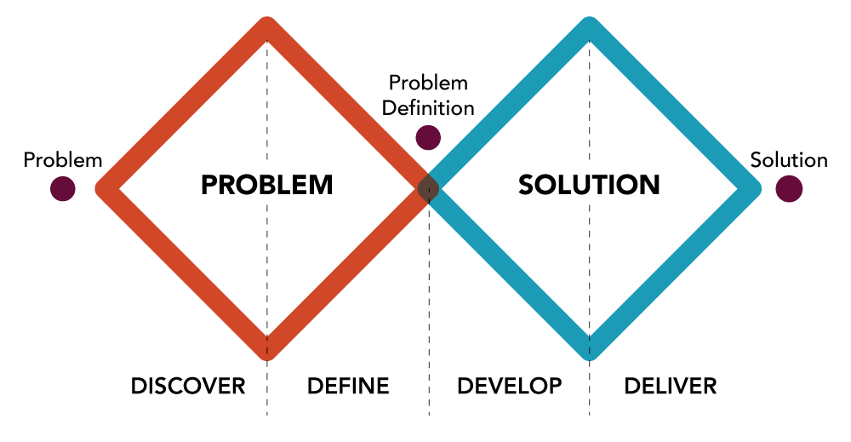
Double Diamond
Notes:
In this session, attendees will be introduced to the session's objective, which is to build a prototype for an event attendee app. Original Content: # - Outline that attendees will be introduced to the session’s objective. # - Explain that the goal is to build a prototype for an event attendee app.

Slide 5
The Truth Curve
Believability of Information
Can we build a business here?
Should we build it?
Fantasy
NEED AND SOLUTION
PRODUCT /MARKET FIT
Concept credit: Giff Constable
PAPER TESTS
PROTOTYPE
WIZARD OF OZ
PRICE TEST
PUBLIC RELEASE
SCALABILITY
CONVERSATIONS
BETA
OPTIMISATION
Level of Effort / Investment
$$© 2022 Jeff Gothelf \& Josh Seiden All Rights Reserved$$
Notes:
In this session, attendees will be introduced to the session's objective, which is to build a prototype for an event attendee app. Original Content: # - Outline that attendees will be introduced to the session’s objective. # - Explain that the goal is to build a prototype for an event attendee app.

Slide 6
The New World of AI Driven Prototyping
Notes:
AI prototyping represents a new frontier in software development. It leverages artificial intelligence to create and modify prototypes quickly, fostering an environment of rapid iteration and innovation.

Slide 7
Types of AI Development Tools
No-Code Platforms
No-code platforms enable users to create AI applications without writing any code, making development accessible to non-programmers.
Automated Coding Assistants
Automated coding assistants provide suggestions and code snippets to developers, speeding up the coding process and improving efficiency.
Machine Learning Frameworks
Machine learning frameworks offer libraries and tools for building sophisticated AI models, making it easier for developers to implement machine learning.
Notes:
There are various types of AI development tools available today, including no-code platforms, automated coding assistants, and machine learning frameworks. Each tool serves a unique purpose in facilitating the prototyping process.

Slide 8
Prototyping Tools
Category | AI Chatbot |  | Web Development Environment |  |  |  | IDE / Code Editor
Tool | ChatGPT | Claude | Bolt | Lovable | v0 | Replit | Cursor
Basics Features
Writes code | Yes | Yes | Yes | Yes | Yes | Yes | Yes
Allows code editing | No | No | Yes | No | Yes | Yes | Yes
Hosts client | Yes | Yes | Yes | Yes | Yes | Yes | Yes
Hosts server | No | No | Yes (with Supabase) | Yes (with Supabase) | Yes (with Vercel) | Yes | No
Hosts database | No | No | Yes (with Supabase) | Yes (with Supabase) | Yes (with Supabase) | Yes | No
Deploys to consistent URL | Yes | No | Yes | Yes | Yes | Yes | No
Templates / pre built components | No | No | No | Yes | Yes | No | No
Advanced Features
System prompts | No | No | Yes | Yes | Yes | No | Yes
Visual edits | No | No | Yes | Yes | Yes | No | No
Forks | No | No | Yes | Yes | Yes | Yes | No
Reasoning | Yes | Yes | Yes | No | Yes | Yes | Yes
Diffs (only replace targetted content) | No | No | Yes | No | Yes | Yes | Yes
Context control (pick relevant files) | No | No | Yes | No | No | Yes | Yes
Chat only mode (no code edits) | No | No | No | Yes | No | No | No
Runs console / database commands | No | No | Yes (with Supabase) | Yes (with Supabase) | No | Yes | Yes
Terminal access | No | No | Yes | No | No | Yes | Yes
Custom domains | No | No | Yes (with Netlify) | Yes (with Netlify) | Yes | Yes | No
External Integrations
Github import | No | Yes | Yes | Yes | No | No | Yes
Github export | No | No | No | Yes | No | Yes | Yes
Stripe | No | No | No | Yes | No | Yes | No
Supabase | No | No | Yes | Yes | Yes | No | No
Email | No | No | No | Yes (Resend) | No | Yes (SendGrid) | No
OpenAI | No | No | Yes | Yes | Yes | Yes | No
Antrhropic | No | No | Yes | Yes | Yes | Yes | No
Netlify (web hosting) | No | No | Yes | Yes | No | No | No
Figma | No | No | No | Yes (with Builder.io) | Yes | No | No
App Types
Web apps (React / Next) | Yes | Yes | Yes | Yes | Yes | Yes | Yes
Web apps (Python) | No | No | No | No | No | Yes | Yes
Mobile Apps (Expo) | No | No | Yes | No | No | Yes | Yes

Slide 9
Benefits: Speed, Efficiency, and Reduced Manual Coding
Faster Backlog Refinement: With rapid prototyping powered by AI, you can validate product backlog items much sooner. This means that during backlog refinement, you’re working with data and user feedback almost in real time, enabling you to reorder features based on what truly delivers value.
Shorter Feedback Loops: AI allows for quick iteration—much like a sprint review that immediately highlights what works and what needs reworking. This accelerates the “truth curve” by moving ideas from mere concepts to validated features within fewer sprints.
Data-Driven Decision Making: As a product owner, you rely on feedback to make informed decisions. AI tools can analyze user interactions and prototype performance instantly, reducing uncertainty and providing clear signals on which user stories to push forward.
Enhanced Predictability and Value Delivery: Faster iteration means less time spent on assumptions. Instead of waiting for long release cycles to learn whether an idea holds up, you can adjust the product backlog quickly, ensuring that every sprint delivers increments that are both valuable and aligned with user needs.
Notes:
The adoption of AI in prototyping offers multiple benefits, including significantly increased speed and efficiency in the development process, and a marked reduction in the need for manual coding, allowing developers to focus on more strategic tasks.

Slide 10
Engaging User Feedback: The Limitations of Static Mockups
Static designs often fail to convey the complete user experience.
Users struggle to provide feedback on non-interactive interfaces.
Misunderstandings of static mockups can necessitate additional revisions.
Notes:
Static wireframes and mockups can limit the user's ability to engage with the design. This often leads to feedback that lacks depth, as users may not fully grasp the design's intent. Additionally, misinterpretations can result in unnecessary rework, complicating the development process and consuming valuable time and resources.

Slide 11
AI Prototyping Slashes Development Time
Generative AI tools explore diverse design alternatives in minutes.
AI coding assistants generate functional prototypes from specifications.
Notes:
AI prototyping has revolutionized the development process by significantly reducing the time required. Generative AI tools can quickly explore various design alternatives, while AI coding assistants can create functional prototypes based on clear specifications. Additionally, automated testing mechanisms can identify the majority of usability issues prior to human review, ensuring a smoother development cycle.

Slide 12
Boost Innovation: AI Expands Solution Spaces by
Machine learning algorithms identify non-obvious patterns and connections.
Product owners can evaluate more concepts before committing.
AI-powered ideation promotes breakthrough product innovations.
Notes:
AI significantly boosts innovation by expanding the range of potential solutions. Machine learning algorithms excel at revealing patterns that might be overlooked, allowing product owners to assess a much larger array of concepts. This capacity for rapid evaluation and ideation can lead to groundbreaking innovations in product development.

Slide 13
Data-Driven Decisions Improve Feature Success Rate
AI analytics predict user engagement patterns from early prototype data.
Machine learning models simulate thousands of usage scenarios.
Evidence-based prioritization replaces opinion-based debates.
Notes:
Utilizing data analytics powered by AI can significantly enhance decision-making. By predicting user engagement through early prototype data, teams can make informed decisions. Machine learning models can simulate numerous usage scenarios, and evidence-based prioritization helps eliminate subjective discussions, leading to a higher feature success rate.

Slide 14
Secure Stakeholder Buy-In Faster with AI Prototypes
Realistic simulations enable stakeholders to experience product concepts.
AI-generated alternatives allow real-time adjustment during reviews.
Visualization of complex data makes abstract concepts immediately understandable.
Notes:
AI prototypes facilitate quicker stakeholder buy-in by providing realistic simulations that bring product concepts to life. During review processes, AI can generate alternative designs that stakeholders can adjust in real-time. Furthermore, visual representations of complex data help clarify abstract concepts, making discussions more productive.

Slide 15
Reduce Product Development Costs with AI
Virtual prototyping minimizes physical testing expenses.
AI-powered risk detection resolves issues at the prototype stage.
Automated processes reduce manual labor and associated costs.
Notes:
Implementing AI in product development can lead to significant cost reductions. Virtual prototyping allows teams to test concepts without incurring physical expenses. AI can also detect potential risks during the prototyping phase, preventing costly mistakes later. Automated processes streamline workflows, further decreasing manual labor costs.

Slide 16
AI Prototyping Best Practices for Product Owners
Define clear objectives and success criteria for AI prototypes.
Leverage pre-trained models and patterns to accelerate development.
Continuously gather user data and refine based on feedback.
Notes:
For product owners, establishing effective AI prototyping practices is crucial. It begins with defining clear objectives and success criteria to align teams. Utilizing pre-trained models can significantly enhance development speed, while ongoing user data collection ensures that prototypes are continually refined based on real feedback.

Slide 17
The Challenge
The challenge
Ideate
Interview a user
Validate and Capture user needs
Proces user needs with ChatGPT/ Claude
Data Capture
Prompting
Build a prototype with bolt.new/ v0.dev/ Replit
Create a PRD or a Use Case and feed it to the machine
For example Write a PRD for an app for attendees of an event. Then use the PRD or Use Case to create a Prompt for your protoyping tool.
Build & Test prototype and Validate user needs
Test and Interview with the user
Notes:
In this step, we present the challenge of building an application for event attendees. Interview users to capture their needs using sample questions provided. An example prompt is also included to guide the process. Original Content: # Slide 4: Step 2 - Presenting the Challenge # - Explain the challenge: “Build an application for event attendees.” # - Instruct them to interview a user to capture needs. # - Provide sample interview questions such as: # 1. What is your role at this event? # 2. What types of professional events do you attend? # 3. What challenges do you face at events? # 4. What features would make an event app indispensable for you? # - Include an example prompt: "Build me an app for attendees of an event. I’ll help you create an event attendee app with features like schedule viewing, session details, and personal agenda management."

Slide 18
Conducting the Interview
Run the Interview
Capture responses. For example on post-it notes
Ask About User's Role
Inquire about the user’s role
Discuss professional events they attend
Notes:
In Step 3, attendees should conduct the interview, capture responses on post-it notes, ask about the user’s role and professional events, and use visuals to represent interviews and note-taking. Original Content: # Slide 5: Step 3 - Conducting the Interview # - Instruct attendees to run the interview with a user and capture responses on post-it notes. # - Remind them to ask about the user’s role and the professional events they attend. # - Include visuals or icons representing interviews and note-taking.

Slide 19
Sample Interview Questions
Understanding the User’s Role and Background
Can you describe your role at this event and what you hope to achieve? What types of professional events do you typically attend, and what draws you to them?
Uncovering Pain Points and Challenges
What challenges or frustrations do you face when attending events? Have you ever experienced difficulties managing your schedule or keeping track of session details? If yes, please explain.
Identifying Must-Have App Features
What features would make an event app indispensable for you? How important are functionalities like real-time schedule viewing, session details, and personal agenda management in enhancing your event experience?
Exploring Further Opportunities
Can you recall a recent experience where a digital tool (or its absence) significantly impacted your event experience? What improvements or additional features would you suggest to better support your needs at events?
Notes:
Here are some sample interview questions for event attendees. Ask about their role at the event, the types of professional events they attend, challenges they face, and features that would make an event app indispensable. Original Content: # - Provide sample interview questions such as: # 1. What is your role at this event? # 2. What types of professional events do you attend? # 3. What challenges do you face at events? # 4. What features would make an event app indispensable for you?

Slide 20
Translating Insights
Photograph or Transcribe Post-its or record the audio and create a transcript.
Use ChatGPT for Data Conversion
Convert captured data into a concise summary
Create a clear prototype prompt
Example Output
“Build me an app for event attendees that offers schedule viewing, session details, and personal agenda management.”
Notes:
In Step 4, groups should photograph or transcribe their post-its. Use ChatGPT to convert this data into a concise summary and clear prototype prompt. For example, create an app for event attendees with schedule viewing and personal agenda management. Original Content: # Slide 6: Step 4 - Translating Insights # - Explain that groups should photograph or transcribe their post-its. # - Instruct them to use ChatGPT to convert their captured data into a concise summary and clear prototype prompt. # - Example output: “Build me an app for event attendees that offers schedule viewing, session details, and personal agenda management.”

Slide 21
For example when Using ChatGPT
Upload photo from post its or the transcript of the interview in ChatGPT Give ChatGPT the following Prompt: I want to build a digital prototype for an app that can be used by people visiting a conference. We will build the app in bolt.new. Analyse the image attached and use the analysis to write a prompt that I can use in bolt.new The prompt for bolt.new should convey the type of user and their needs. It should also explain what the goal of the attendees is when visiting an event and describe certain features such as:
Features of the App
Schedule viewing
Session details
Personal agenda management
Notes:
Instruct users to use ChatGPT to convert their data into concise summaries and clear prototype prompts. For example, creating an app for event attendees with features like schedule viewing and personal agenda management. Original Content: # - Instruct them to use ChatGPT to convert their captured data into a concise summary and clear prototype prompt. # - Example output: “Build me an app for event attendees that offers schedule viewing, session details, and personal agenda management.”

Slide 22
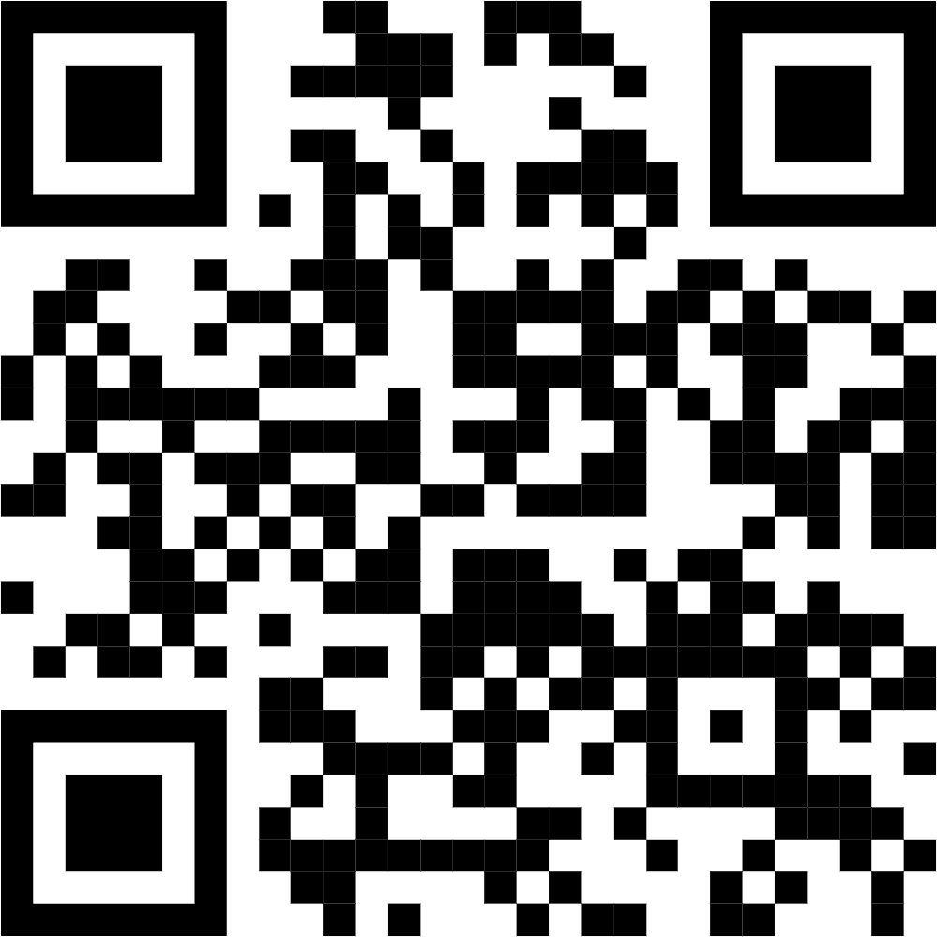
Prototype Creation Bolt.new
Visit Bolt.new
Create Account
Enter Prompt from ChatGPT
Notes:
We will start by creating an account on Bolt.new, a popular platform for AI prototyping. This process is simple and user-friendly, setting the stage for the next steps.

Slide 23
Building the Prototype in Bolt
Input Summary into Bolt
Groups should enter their summaries into the Bolt system
Bolt Generates Prototype
Bolt will create a prototype based on the provided summary
Observe AI Translation
Encourage observation of how AI converts insights into a prototype
Notes:
Groups should input their summaries into Bolt. Bolt will generate a prototype based on these summaries. Encourage observation of how AI translates insights into a working app prototype. Original Content: # - Instruct groups to input the summary into Bolt using the prompt. # - Explain that Bolt will generate the prototype based on the summary. # - Encourage them to observe how AI translates their insights into a working app prototype.

Slide 24
Testing & Validation
User Interview
Assessing App's Effectiveness
Does the app address your main needs at the event?
Evaluating Features
Which features do you find most useful or lacking?
Navigation Intuitiveness
How intuitive is the navigation?
Suggestions for Improvement
What improvements would enhance your experience?
Usage at Real Events
Would you use this app at a real event? Why or why not?
Notes:
Here are five validation questions for the event app: Does the app address your main needs? Which features are most useful or lacking? How intuitive is the navigation? What improvements would enhance your experience? Would you use this app at a real event and why? Original Content: # - Provide a set of 5 non-leading validation questions: # 1. Does the app address your main needs at the event? # 2. Which features do you find most useful or lacking? # 3. How intuitive is the navigation? # 4. What improvements would enhance your experience? # 5. Would you use this app at a real event? Why or why not?

Slide 25
Wrap-Up & Key Take aways
Importance of User Interviews
Gathering valuable insights from users
Understanding user needs and pain points
Translating Insights to a Clear Prompt
Converting user feedback into actionable prompts
Ensuring clarity and relevance in prompts
Rapid Prototyping
Quickly creating prototypes to test ideas
Iterating based on feedback
Encourage Iteration and Continuous Learning
Emphasizing the importance of refining ideas
Notes:
In this session, we highlighted the importance of user interviews, translating insights into clear prompts, and rapid prototyping. We encourage continuous iteration and learning. Please reach out with any follow-up questions. Original Content: # - Summarize the session: importance of user interviews, translating insights to a clear prompt, and rapid prototyping. # - Encourage iteration and continuous learning. # - Include your contact details for follow-up questions.

Slide 26
Brassersplein 1 2612 CT, Delft The Netherlands | +31 15 241 18 00 info@prowareness.nl | www.scrum.nl www.prowareness.nl

